Slide 1
Tech-Enabled Managed Services: Not Your Average Outsourcing
Dan LeSueur, Jason Jones, Phil Rowell

Slide 2
Financial pressures mean cutting short & long-term cost.
Growing difficulty in recruiting & retaining talent.
The Impossible Challenge
Outsourcing is a culture killer.
Workforce reductions puts excellence at risk.
Jack of too many trades.
Notes:
We are seeing challenges converge in a way this industry hasn’t seen in the past five decades
>cost (inflation, supply chain constraints, workforce shortages/wage increases and more)
<revenue (reimbursement declines, unpredictable patient flow, increasing care trends away from hospitals, etc.)
>competitive environment for recruiting/retaining talent (hospitals/systems are often left at a disadvantage when it comes to ancillary functions like reporting & analytics, remote first workforce etc.)
While we know the benefits of partnering for specialized domain expertise, we constantly struggle to understand if the negative impacts are worth the potential gains from outsourcing.
At the same time, organizations are growing frustrated with the long-term impacts of workforce reductions on quality & staff engagement
We’re all waking up to fact that we can’t be the best at everything, we need to be clear about where we can & want to be the best ….and work towards focusing our efforts
As described by one CFO, this feels like "an impossible challenge" or "a perfect storm"

Slide 3
You don’t need to cut performance, people, or morale to cut costs​.

Slide 4
The Value of Tech-Enabled Managed Services (TEMS)
Financial pressures mean cutting short & long-term costs.
There’s difficulty in recruiting and retaining talent, but outsourcing is a culture killer.
Workforce reductions put excellence at risk.
Jack of too many trades
Alleviate Financial Pressure
Care for
Team Members
Ensure Dependable Performance
Partner for Specialization
Reduce labor costs without cutting performance, people, or morale.
Notes:
Let’s get more specific about what this means for you and your team….
We are laser focused on solving the challenges that our clients are facing today in each of these areas
Our goal is to ensure we are….
alleviating financial pressures near and long-term
caring for employees in a mission consistent way
meeting objectives & opportunities for our clients
..and being the best long-term partner we can be, brining expertise and specialization that allow you to focus on your core mission

Slide 5
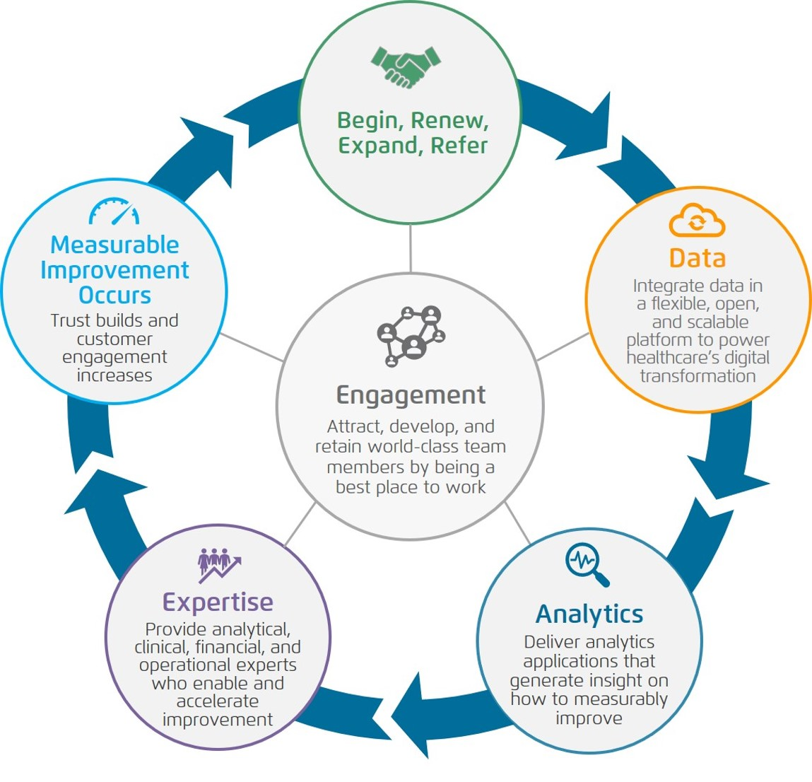
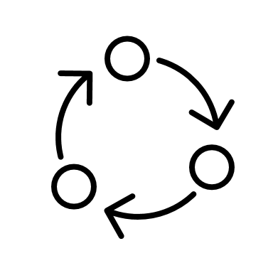
How We Do This:
TEMS INGREDIENTS
OUR BUSINESS MODEL “FLYWHEEL”
We rebadge your entire existing team and take on any open/budgeted positions.
PEOPLE
We maintain & enhance your existing processes.
PROCESSES
TECHNOLOGY
We own implementation and adoption of our technology for your success.
DATA
We elevate data as a strategic asset.
We drive efficiencies over time to enable cost savings without compromises.
Notes:
The how is simple:
We take your people as they are, doing the work they are doing today, rebadge them to be Health Catalyst team members.
We train them on best practices that we observe through 500+ customers and up-level their skills
We equip them with technologies that automate lower-level task so they can work at the top of license.
Accelerate the journey to data adoption & elevating data as a strategic asset to assist decision making at the leadership and day to day operational level.
We do this while keeping people at the heart of what we do everyday.
You’ll notice at the center of how (Flywheel) we achieve our mission (to be the catalyst for massive, measurable, data-informed healthcare improvement) is team member engagement. Team member engagement is foundational to everything we do and is the #1 priority of our CEO and broader leadership team. When team members feel connected to our mission and are listened to, cared for, and respected at an extraordinary level, they produce outstanding work, which enables our customers to measurably improve.
Giving team members opportunities to grow and learn beyond what is available to them today is just good business for us.
*********************************
Our Mission
Our mission is to be the catalyst for massive, measurable, data-informed healthcare improvement. We fulfill our mission through a confluence of the following elements:
• Data Platform: integrate data in a flexible, open, and scalable platform to power healthcare’s digital transformation;
• Analytics Applications: deliver insights on how to measurably improve through the use of analytics applications;
• Services Expertise: enable data-informed improvement by providing analytical, clinical, financial, and operational experts; and
• Engagement: attract, develop, and retain world-class team members by being a best place to work.
The Health Catalyst Flywheel
We accomplish our mission with each of our customers by following a process we call the Health Catalyst Flywheel or the Flywheel. This process includes delivering on the three components of our Solution: data platform, analytics applications, and services expertise, which together drive measurable improvements. At the center of the Flywheel is the engagement of our team members. Team member engagement is foundational to everything we do and is the #1 priority of our CEO and broader leadership team. When team members feel connected to our mission and are listened to, cared for, and respected at an extraordinary level, they produce outstanding work, which enables our customers to measurably improve. As customers realize improvements, their trust in Health Catalyst builds, their engagement in our shared work increases, and they choose to renew and expand their relationship with us, while also referring Health Catalyst to key decision-makers at other potential customers. Customer renewal, expansion, and referral produce growing, scalable, and predictable financial performance.

Slide 6
Focused on the WHOLE of Every Team Member
Above-market HSA company contribution
Many brand-name medications at no cost
85-90% of benefit-cost paid by company
No-cost virtual physical therapy
Low- or no-cost virtual urgent and preventive care
Fitness reimbursement
Reduction in medical premium with Wellness Participation
Flexible paid time off
Flexible work schedules
12-week paid parental leave
No-cost access to TAVA Health (virtual behavioral health visits)
Free Headspace account (mindfulness)
Affinity groups and leadership listening sessions for members and allies of underrepresented groups
HEALTH More than just medical, dental, and vision
WELLBEING Support for mental health and a sustainable life
Target above-market-base salary with 12 growth levels in each role
Restricted stock units (RSUs)
4% 401k match
Reimbursements for cellphone, Internet, and other home office equipment
Company bonus eligibility
Spot bonuses
Motivosity: peer-to-peer gifting
Paid ongoing education and development
Health Catalyst University certification programs
New career opportunities, promotions
Internal leadership and development training
Exposure to—and experience with—best practices and industry trends across a broad client base
COMPENSATION Above-market total compensation
GROWTH Education and opportunities

Slide 7
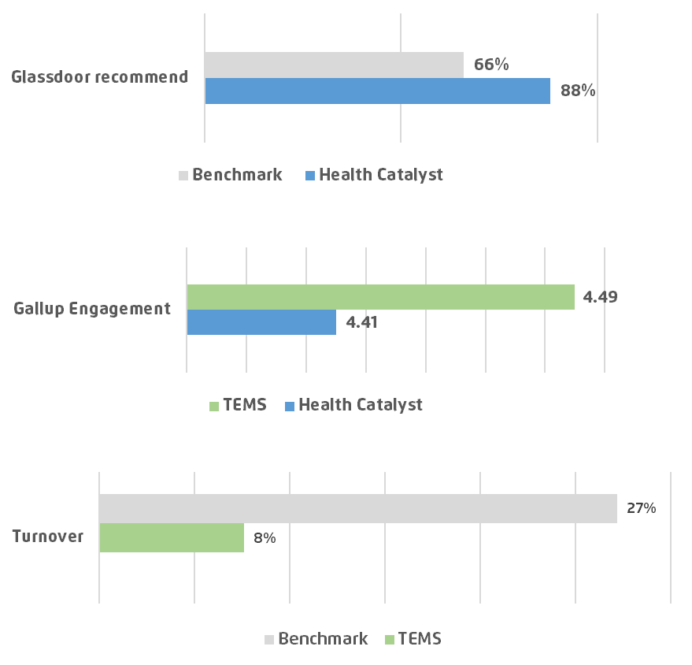
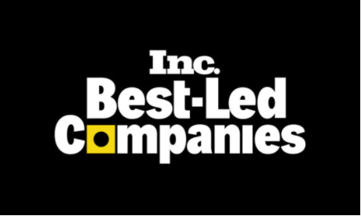
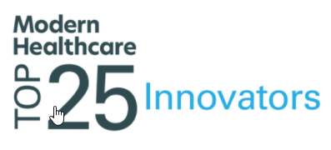
Repeatedly Recognized as a “Best Place to Work”
HC engagement score is in the 97th percentile of Gallup's database of participant engagement. TEMS engagement is higher still.

Slide 8
“Health Catalyst is easily the most employee-friendly, well-led company I have ever worked for....”
“It is so refreshing to be with a company where the CEO and management team ‘walk-the-talk’…”
The only outsourcing decision that increases employee engagement
“I am appreciative of Health Catalyst for always being supportive of me personally.”
“This is the best company I have ever worked for.
Caring. Compensation. Encouragement to grow.”

Slide 9
Tech-Enabled Managed Services (TEMS) Creates a Win, Win, Win
Health System
Reduces labor costs
Governs performance
contractually
Team Members
Enjoy a world-class experience
Continue with the same work
and tenure
Health Catalyst
Adds valuable team members
Achieves a profit long-term

Slide 10
Health Catalyst TEMS Framework
PLATFORM
APPLICATIONS & ACCELERATORS
TEMS POSSIBILITIES
Clinical Chart Abstraction
Data & Analytics Platform
Quality Improvement
Population Health Management
Financial Empowerment
Reporting & Analytics
Data warehouse, source connectors, reusable data logic, machine learning, augmented intelligence, terminology services, expert data collections, real-time streaming & interoperability, big data
Analytics dashboards, opportunity identification, improvement in quality measures and patient safety, patient engagement
Risk coding, total cost of care, risk stratification, quality measures, point-of-care integration, care management, patient engagement
Activity-based costing, planning & budgeting, labor productivity management, comprehensive mid-revenue cycle management
EDW & Data Operations
Ambulatory Support Operations
Cross-Domain
Costing as
a Service
Benchmarking, KPI dashboards, self-service analytics, augmented intelligence, clinician & patient engagement
And many
more…
Notes:
Our TEMS framework can be applied to any functional area (people/processes/data) that is enabled by our technologies.
We’ve been offering this service in areas like chart abstraction and reporting & analytics but also see tremendous opportunities in other domains such as ….

Slide 11
Poll Question: What areas have you considered outsourcing?
Notes:
Reporting & Analytics​
Chart Abstraction​
Cost Accounting​
Revenue Cycle​
Financial Planning & Budgeting​
Performance Improvement ​
Care Management​
Patient Scheduling​
Informatics​
Other​
​

Slide 12
Tech-Enabled Managed Services (TEMS) Creates a Win, Win, Win
Health System
Reduces labor costs
Governs performance
contractually
Team Members
Enjoy a world-class experience
Continue with the same work
and tenure
Health Catalyst
Adds valuable team members
Achieves a profit long-term
Notes:
Opening: “JD” is not the most common path to CAO and you still keep a toe in law. What is the connection? You spent some time in Australia. Why’d you go, why’d you stay, what did you bring back to apply to Champaign and Oklahoma City?
Staffing fears: Staffing is a concern #1 for many healthcare executives. We immediately think of providers. What has kept you up at night regarding staffing as a CAO? What problems could you see? What have you worried might be “lurking under the bed”? [[Theme: Focus disproportionately on current, general concerns of healthcare executives and past concerns for you.]]
Carle: At Carle, you made the shift to TEMS. What other options did you consider? Who was involved in making the decision? How long did the process take? What would you change? What was it like to be “rebadged” yourself? [[Theme: Focus on prior decision making process and make it real through example and personal, lived experience.]]
INTEGRIS: Now, you are building up an analytic team in another system. What strikes you as most similar and different about the circumstances and path forward? [[Theme: Focus on current state and how you are moving forward. This can include significant changes in operational systems of record to how you are staffing to address meeting organizational aspirations. What are you seeing that is portable across client versus unique? This could be a good place to insert need to leverage capabilities within operational systems (e.g., Epic, Workday) and the fact that you worked at Cerner and work with Epic.]]
Closing: You describe yourself as a futurist, what is a good time horizon for us to select in managing our way out of the last 3 years? What is the role of analytics and TEMS in achieving a great state for health and healthcare? [[Theme: Focus fur

Slide 13
Poll Question: What areas within your Reporting & Analytics department have you considered outsourcing?
Notes:
BI center of excellence
Embedded EHR
Embedded Labor
Embedded ERP
Advanced statistics & Data science
Financial Analysis

Slide 14
Tech-Enabled Managed Services (TEMS) Creates a Win, Win, Win
Health System
Reduces labor costs
Governs performance
contractually
Team Members
Enjoy a world-class experience
Continue with the same work
and tenure
Health Catalyst
Adds valuable team members
Achieves a profit long-term
Notes:
Opening: “JD” is not the most common path to CAO and you still keep a toe in law. What is the connection? You spent some time in Australia. Why’d you go, why’d you stay, what did you bring back to apply to Champaign and Oklahoma City?
Staffing fears: Staffing is a concern #1 for many healthcare executives. We immediately think of providers. What has kept you up at night regarding staffing as a CAO? What problems could you see? What have you worried might be “lurking under the bed”? [[Theme: Focus disproportionately on current, general concerns of healthcare executives and past concerns for you.]]
Carle: At Carle, you made the shift to TEMS. What other options did you consider? Who was involved in making the decision? How long did the process take? What would you change? What was it like to be “rebadged” yourself? [[Theme: Focus on prior decision making process and make it real through example and personal, lived experience.]]
INTEGRIS: Now, you are building up an analytic team in another system. What strikes you as most similar and different about the circumstances and path forward? [[Theme: Focus on current state and how you are moving forward. This can include significant changes in operational systems of record to how you are staffing to address meeting organizational aspirations. What are you seeing that is portable across client versus unique? This could be a good place to insert need to leverage capabilities within operational systems (e.g., Epic, Workday) and the fact that you worked at Cerner and work with Epic.]]
Closing: You describe yourself as a futurist, what is a good time horizon for us to select in managing our way out of the last 3 years? What is the role of analytics and TEMS in achieving a great state for health and healthcare? [[Theme: Focus fur

Slide 15
Tech-Enabled Managed Services: Not Your Average Outsourcing
Dan LeSueur, Jason Jones, Phil Rowell

Slide 16
Would you like to win a complimentary pass to HAS 24?

Slide 17
