Slide 1
2023 Mid-Year CPT®/HCPCS Code Set Updates
Mikki Fazzio, RHIT, CCS, Principal Content Integrity Consultant

Slide 2
Disclaimer Statement This presentation was current at the time it was published or provided via the web and is designed to provide accurate and authoritative information regarding the subject matter covered. The information provided is only intended to be a general overview with the understanding that neither the presenter nor the event sponsor is engaged in rendering specific coding advice. It is not intended to take the place of either the written policies or regulations. We encourage participants to review the specific regulations and other interpretive materials, as necessary. All CPT® codes are trademarked by the American Medical Association (AMA) and all revenue codes are copyrighted by the American Hospital Association (AHA).

Slide 3
Overview of Additions, Revisions, and Deletions By Section
CPT® Additions
CPT® Revisions
CPT® Deletions
HCPCS Additions
HCPCS Revisions
HCPCS Payment Changes
HCPCS Deletions
Questions

Slide 4
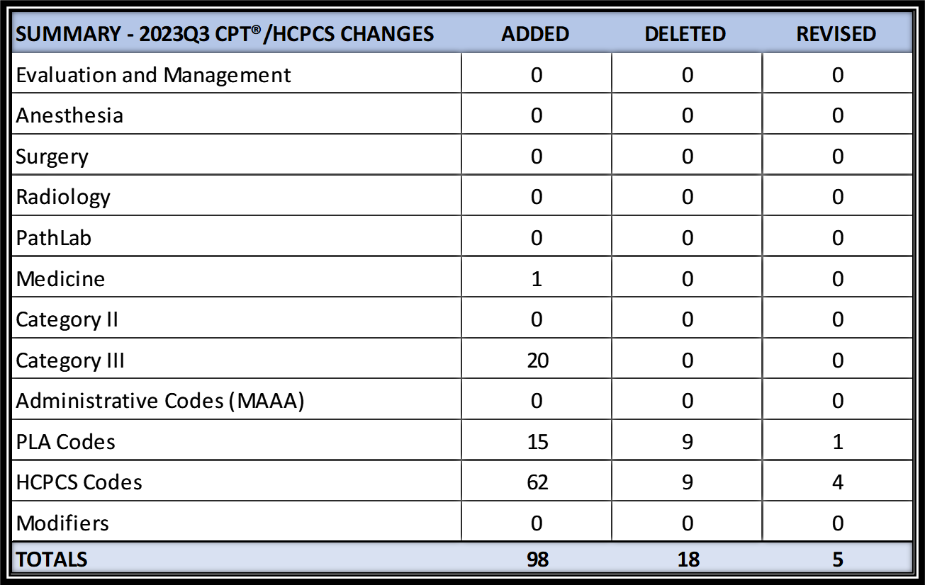
Overview By Section

Slide 5
CPT® Additions

Slide 6
CPT® Additions
PLA Codes- Effective 7/1/2023
0387U, Oncology (melanoma), autophagy and beclin 1 regulator 1 (AMBRA1) and loricrin (AMLo) by immunohistochemistry, formalin-fixed paraffin-embedded (FFPE) tissue, report for risk of progression (AMBLor®melanoma prognostic test)
0388U, Oncology (non-small cell lung cancer), next-generation sequencing with identification of single nucleotide variants, copy number variants, insertions and deletions, and structural variants in 37 cancer-related genes, plasma, with a report for alteration n detection (InVisionFirst®-Lung Liquid Biopsy)
0389U, Pediatric febrile illness (Kawasaki disease [KD]), interferon alpha-inducible protein 27 (IFI27) and mast cell-expressed membrane protein 1 (MCEMP1), RNA, using reverse transcription polymerase chain reaction (RT-qPCR), blood, reported as a risk score for KD (KawasakiDx)
0390U, Obstetrics (preeclampsia), kinase insert domain receptor (KDR), Endoglin (ENG), and retinol-binding protein 4 (RBP4), by immunoassay, serum, algorithm reported as a risk score (PEPredictDx)
0391U, Oncology (solid tumor), DNA and RNA by next-generation sequencing, utilizing formalin-fixed paraffin-embedded (FFPE) tissue, 437 genes, interpretive report for single nucleotide variants, splice-site variants, insertions/deletions, copy number alterations, gene fusions, tumor mutational burden, and microsatellite instability, with algorithm quantifying immunotherapy response score (Strata Select™)
Notes:
Proprietary names in parenthesis at the end and in my references I have all the company websites.
0387U – AMBLor melanoma prognostic test- From company called AMLo Biociences. New test based on two protein markers (AMBRA1 and loricrin) that are normally present in the upper layer of the skin (epidermis). Loss of both of these markers in the skin overlying the tumor in early stage (Stage I and II) melanomas is associated with high risk of progression of the tumor, while one or both are retained in the epidermis overlying low-risk tumours.
0388U- InVisionFirst- Lung Liquid Biopsy- From a company called Neo Genomics. Liquid biopsy test that detects the genes that are relevant to the treatment and management of advanced non-small cell lung cancer. With tissue based testing sometimes there’s inadequate or insufficient tissue, challenging biopsy locations, and the turn around time may be longer. This test has a turnaround time for test results in 7 days. More sensitive and specific than tissue biopsy to accurately identify tumor mutations found at very low levels in the blood.
0389U- KawasakiDx. Company called mProbe. Developed a test for Kawasaki disease, which is acute vasculitic lesion of unknown etiology in infants and children. The clinical diagnosis is mainly based on clinical features combined with systemic vasculitis and laboratory tests. Intravenous immunoglobulin is the usual treatment. Early dx is the most effective way to avoid higher risk of complications. Traditional dx methods rely on clinical experience of physicians which can lead to delayed or missed treatment. This blood test can diagnose at a very early stage in children when they first start running fever and it’s over 90% accurate.
0390U-PEPredictDx. Same company mProbe. Developed a test for earlier screening of pre-eclampsia. Typical timeframe that preeclampsia can be predicted is about 20 weeks of pregnancy. This test can predict preeclampsia as early as 11 weeks- 90% accuracy rate. So the patient has two extra months of treatment than they would get with typical testing.
0391U- Strata Select. Strata Oncology. Strata Select is a pan-solid tumor molecular profiling test for patients with advanced cancer that provides treatment selection guidance for immunotherapy. So it helps the physician to avoid treatment options n which the patient isn’t likely to respond and avoid unnecessary combination chemotherapy.

Slide 7
CPT® Additions
PLA Codes- Effective 7/1/2023
0392U, Drug metabolism (depression, anxiety, attention deficit hyperactivity disorder [ADHD]), gene-drug interactions, variant analysis of 16 genes, including deletion/duplication analysis of CYP2D6, reported as impact of gene-drug interaction for each drug (Medication Management Neuropsychiatric Panel)
0393U, Neurology (e.g., Parkinson disease, dementia with Lewy bodies), cerebrospinal fluid (CSF), detection of misfolded α-synuclein protein by seed amplification assay, qualitative (SYNTap® Biomarker Test)
0394U, Perfluoroalkyl substances (PFAS) (e.g., perfluorooctanoic acid, perfluorooctane sulfonic acid), 16 PFAS compounds by liquid chromatography with tandem mass spectrometry (LC-MS/MS), plasma or serum, quantitative (PFAS Testing & PFASure™)
0395U, Oncology (lung), multi-omics (microbial DNA by shotgun next-generation sequencing and carcinoembryonic antigen and osteopontin by immunoassay), plasma, algorithm reported as malignancy risk for lung nodules in early-stage disease (OncobiotaLUNG)
0396U, Obstetrics (pre-implantation genetic testing), evaluation of 300000 DNA single-nucleotide polymorphisms (SNPs) by microarray, embryonic tissue, algorithm reported as a probability for single-gene germline conditions (Spectrum PGT-M)
Notes:
0392U Medication Management Neuropsychiatric Panel. Company called Genetworx developed a test that looks at patient’s genetics to help determine the most effective medication(s) for them for things like depression, anxiety, ADHD. Many times patients have to try out different ones to see which work for them… or which doesn’t give them undesirable side effects. So using their genes to make the determinations helps to see which medications will work for them to eliminate the “Trying out” of different medications.
0393U SYNTap® Biomarker Test. Company called Amprion. Test is done on cerebrospinal fluid. Can tell patients proactively how their brains are aging prior to symptoms. Helps early diagnosis of brain diseases such as parkinsons, Lewy bodies, alzheimers, and dementia aiding in preventative measures.
0394U PFAS Testing & PFASure. National Medical Services Labs. A series of tests that to help determine the effects of environmental exposure on human health. These tests also provide invaluable insights on levels of environmental chemicals and information about their potential toxicity. (examples- carbon monoxide, oil spill exposures, pesticides etc. long list on website) NMS Labs has two distinct panels that can be done depending on specific needs
0395U OncobiotaLUNG. Company called Micronoma. A liquid biopsy assay for lung cancer detection in early stages by looking for microbiome markers.
0396U Spectrum PGT-M. Company called Natera. Developed genetic testing to boost IVF success. Evaluates embryos for chromosomal abnormalities and known inherited genetic conditions. Embryo biopsy and parental blood/cheek swab. Results only take 5-7 days.

Slide 8
CPT® Additions
PLA Codes- Effective 7/1/2023
0397U, Oncology (non-small cell lung cancer), cell-free DNA from plasma, targeted sequence analysis of at least 109 genes, including sequence variants, substitutions, insertions, deletions, select rearrangements, and copy number variations (Agilent Resolution ctDx FIRST)
0398U, Gastroenterology (Barrett esophagus), P16, RUNX3, HPP1, and FBN1 DNA methylation analysis using PCR, formalin-fixed paraffin-embedded (FFPE) tissue, algorithm reported as risk score for progression to high-grade dysplasia or cancer (ESOPREDICT® Barrett's Esophagus Risk Classifier Assay)
0399U, Neurology (cerebral folate deficiency), serum, detection of anti-human folate receptor IgG-binding antibody and blocking autoantibodies by enzyme-linked immunoassay (ELISA), qualitative, and blocking autoantibodies, using a functional blocking assay for IgG or IgM, quantitative, reported as positive or not detected (FRAT® Folate Receptor Antibody Test)
0400U, Obstetrics (expanded carrier screening), 145 genes by next-generation sequencing, fragment analysis and multiplex ligation-dependent probe amplification, DNA, reported as carrier positive or negative (Genesys Carrier Panel)
0401U, Cardiology (coronary heart disease [CAD]), 9 genes (12 variants), targeted variant genotyping, blood, saliva, or buccal swab, algorithm reported as a genetic risk score for a coronary event (CARDIO inCode-Score (CIC-SCORE))
Notes:
0397U Agilent Resolution ctDx FIRST. Company called Resolution Bioscience. Liquid biopsy for non small cell lung cancer and provides information such as tumor mutation profiling and gene information that assists with choosing treatment.
0398U ESOPREDICT® Barrett's Esophagus Risk Classifier Assay. Company called Previse. analyzes changes in your DNA that may help your gastroenterologist predict whether your Barrett’s esophagus will progress to esophageal cancer in the future.
0399U, FRAT® Folate Receptor Antibody Test, Company called Religen. A blood test taken by pregnant women that Assesses the ability of folate (folic acid) to enter the brain of the fetus by looking for certain antibodies. If folate cannot be distributed to the brain properly it can cause issues such as neural tube defects and autism spectrum disorders.
0400U Genesys Carrier Panel. Company called Genesys Diagnostics. A screening that tests for genes that can be related to certain heredity conditions such as cystic fibrosis, fragile X syndrome, etc to see the risk of passing along to your child.
0401U CARDIO inCode-Score (CIC-SCORE). Company called GENinCode. A genetic test that evaluates the risk for having a cardiovascular event bc they state that genetics make a 50% contribution to the development of cardiovascular events. A significant proportion of events take place in individuals classified in the low and moderate risk groups based on classical cardiovascular risk factors. The inclusion of the genetic load in the clinical assessment makes it possible to attain a more accurate and reliable overall cardiovascular risk score, and identify those patients at highest risk, who may need adjustments to their therapy and therapeutic goals.

Slide 9
CPT® Additions
Category III Codes- Effective 7/1/2023
0791T, Motor-cognitive, semi-immersive virtual reality-facilitated gait training, each 15 minutes (List separately in addition to code for primary procedure)
Use 0791T in conjunction with 97116, Therapeutic procedure, 1 or more areas, each 15 minutes; gait training (includes stair climbing)
0793T, Percutaneous transcatheter thermal ablation of nerves innervating the pulmonary arteries, including right heart catheterization, pulmonary artery angiography, and all imaging guidance
Do not report 0793T in conjunction with 75746, 93503, or 93568.
For percutaneous transcatheter ultrasound ablation of nerves innervating the pulmonary arteries, including right heart catheterization, pulmonary artery angiography, and all imaging guidance, use 0632T, Percutaneous transcatheter ultrasound ablation of nerves innervating the pulmonary arteries, including right heart catheterization, pulmonary artery angiography, and all imaging guidance
Notes:
0791T, GaitBetter uses gamification and semi-immersive VR to simulate motor-cognitive challenges that patients experience in everyday life. Clinically proven to accelerate more positive outcomes and reduce falls by over 70%, GaitBetter’s innovative solution enables clinicians to tailor therapy intensity and specificity to the unique needs of their patients.
Harnessing AI-based gait tracking, patients play a fun and safe ‘game’ as they see their feet movements projected into a VR environment displayed on a TV screen in front of them. Easily added to any treadmill, patients face virtual obstacles to improve gait while performing complex tasks requiring attention, memory, motor planning and execution to enhance motor-cognitive skills. This innovative dual-tasking approach combined with gamified therapy accelerates outcomes while keeping patients immersed, happy and motivated.
0793T
Thermal ablation is done using extreme heat (or in some instances cold) (this will be done through a catheter with a probe in this procedure). Innervate means to supply nerves to, to stimulate, or to supply with energy. So this procedure is the destruction of the nerves of the pulmonary arteries by using laser ablation. Don’t report the following with it because it’s included in the code.
75746, Angiography, pulmonary, by nonselective catheter or venous injection, radiological supervision and interpretation,
93503, Insertion and placement of flow directed catheter (eg, Swan-Ganz) for monitoring purposes, or
93568, Injection procedure during cardiac catheterization including imaging supervision, interpretation, and report; for nonselective pulmonary arterial angiography.

Slide 10
CPT® Additions
Category III Codes- Effective 7/1/2023
0794T, Patient-specific, assistive, rules-based algorithm for ranking pharmaco-oncologic treatment options based on the patient's tumor-specific cancer marker information obtained from prior molecular pathology, immunohistochemical, or other pathology results which have been previously interpreted and reported separately
Includes time spent by the physician, QHP, or clinical staff in submitting the patient’s clinical and existing molecular, laboratory, or pathology result data for algorithmic assessment.
0792T, Application of silver diamine fluoride 38%, by a physician or other qualified health care professional
Notes:
Code 0794T (pharmaco-oncologic treatment ranking) represents rules based algorithm–generated match scores that rank available monotherapies and drug combinations according to their ability to target the patient’s specific cancer
biomarkers. These pharmaco-oncologic treatment ranking options are based only on current Food and Drug Administration (FDA)-approved drugs but may include both on-label and off-label uses for targeted therapies, and additional information
may also be provided on potential active clinical trials that include specifically matched, currently available, therapy options.
0792T- Silver diamine fluoride (SDF) is a liquid substance used to help prevent tooth cavities (or caries) from forming, growing, or spreading to other teeth. Most dentists use a liquid form of SDF containing at least 38 percent of the SDF solution. It’s applied topically, meaning that it’s applied directly to the surface of your teeth.

Slide 11
CPT® Additions
Category III Codes- Effective 7/1/2023
0795T, Transcatheter insertion of permanent dual-chamber leadless pacemaker, including imaging guidance (e.g., fluoroscopy, venous ultrasound, right atrial angiography, right ventriculography, femoral venography) and device evaluation (e.g., interrogation or programming), when performed; complete system (i.e., right atrial and right ventricular pacemaker components)
0796T, Transcatheter insertion of permanent dual-chamber leadless pacemaker, including imaging guidance (e.g., fluoroscopy, venous ultrasound, right atrial angiography, right ventriculography, femoral venography) and device evaluation (e.g., interrogation or programming), when performed; right atrial pacemaker component (when an existing right ventricular single leadless pacemaker exists to create a dual-chamber leadless pacemaker system)
0797T, Transcatheter insertion of permanent dual-chamber leadless pacemaker, including imaging guidance (e.g., fluoroscopy, venous ultrasound, right atrial angiography, right ventriculography, femoral venography) and device evaluation (e.g., interrogation or programming), when performed; right ventricular pacemaker component (when part of a dual-chamber leadless pacemaker system)
(Do not report 0795T, 0796T, 0797T in conjunction with 33274, 75820, 76000, 76937, 77002, 93566, 0795T)
Notes:
For insertion of a complete dual-chamber leadless pacemaker system, report 0795T.
A complete dual-chamber leadless pacemaker system includes two pulse generators, each with a built-in battery and electrode. Implantation of this system is performed using a catheter under fluoroscopic guidance via transvenous
access. One pacemaker is implanted in the right atrium, and one is implanted in the right ventricle. Rarely, for clinical reasons, a complete dual-chamber leadless pacemaker system may be completed in stages, with one pacemaker implanted
into the right ventricle at the initial procedure and the other implanted into the right atrium at a subsequent session
Report 0796T- For insertion of a leadless pacemaker into the right atrium when a single chamber right ventricular leadless pacemaker already exists, in order to complete the dual-chamber leadless pacemaker system
Report 0797T- For insertion of only the right ventricular pacemaker component of a dual-chamber leadless pacemaker system.
33274, Transcatheter insertion or replacement of permanent leadless pacemaker,
75820, Venography, extremity
76000, Fluoroscopy
76937, Ultrasound guidance for vascular access
77002, Fluoroscopic guidance for needle placement
93566, Injection procedure during cardiac catheterization
0795T. Whole system shouldn’t be reported twice or with a part of the system (0796T or 0797T)

Slide 12
CPT® Additions
Category III Codes- Effective 7/1/2023
0798T, Transcatheter removal of permanent dual-chamber leadless pacemaker, including imaging guidance (eg, fluoroscopy, venous ultrasound, right atrial angiography, right ventriculography, femoral venography), when performed; complete system (ie, right atrial and right ventricular pacemaker components)
0799T, Transcatheter removal of permanent dual-chamber leadless pacemaker, including imaging guidance (eg, fluoroscopy, venous ultrasound, right atrial angiography, right ventriculography, femoral venography), when performed; right atrial pacemaker component
0800T, Transcatheter removal of permanent dual-chamber leadless pacemaker, including imaging guidance (eg, fluoroscopy, venous ultrasound, right atrial angiography, right ventriculography, femoral venography), when performed; right ventricular pacemaker component (when part of a dual-chamber leadless pacemaker system)
(Do not report 0798T, 0799T, 0800T in conjunction with 75820, 76000, 76937,77002, 93451, 93453, 93456, 93457, 93460, 93461, 93567, 93566, 93593, 93594,93596, 93597)
(Do not report 0799T, 0800T in conjunction with 33275, 0798T)
Notes:
0798T is the whole complete system being removed. (right atrial and right ventricular components)
For removal of only the right atrial leadless pacemaker component of a complete dual-chamber leadless pacemaker, report 0799T.
For removal of only the right ventricular leadless pacemaker component of a complete dual-chamber leadless pacemaker, report 0800T.
Do not report with imaging such as Venography, fluoroscopy, ultrasound, heart cath codes – all included in the procedure
Do not report with 33275 which is transcatheter removal of a permanent leadless pacemaker and don’t report the removal of the whole system (0798T) with removal of parts of the system (0799T and 0800T)

Slide 13
CPT® Additions
Category III Codes- Effective 7/1/2023
0801T, Transcatheter removal and replacement of permanent dual-chamber leadless pacemaker, including imaging guidance (eg, fluoroscopy, venous ultrasound, right atrial angiography, right ventriculography, femoral venography) and device evaluation (eg, interrogation or programming), when performed; dual-chamber system (ie, right atrial and right ventricular pacemaker components)
0802T, Transcatheter removal and replacement of permanent dual-chamber leadless pacemaker, including imaging guidance (eg, fluoroscopy, venous ultrasound, right atrial angiography, right ventriculography, femoral venography) and device evaluation (eg, interrogation or programming), when performed; right atrial pacemaker component
0803T, Transcatheter removal and replacement of permanent dual-chamber leadless pacemaker, including imaging guidance (eg, fluoroscopy, venous ultrasound, right atrial angiography, right ventriculography, femoral venography) and device evaluation (eg, interrogation or programming), when performed; right ventricular pacemaker component (when part of a dual-chamber leadless pacemaker system)
(Do not report 0801T, 0802T, 0803T in conjunction with 33274, 33275, 75820, 76000, 76937, 77002, 93451, 93453, 93456, 93457, 93460, 93461, 93566, 0795T, 0796T, 0797T, 0798T, 0799T, 0800T)
(Do not report 33274, 33275 when right ventricular single-chamber leadless pacemaker is part of a dual-chamber leadless pacemaker system)
Notes:
For removal and replacement of a complete dual-chamber leadless pacemaker system, report 0801T.
For removal and replacement of only one pacemaker component of a
complete dual-chamber leadless pacemaker system, Report:
0802T
right atrial pacemaker component
0803T
right ventricular pacemaker component (when part of a dual-chamber
leadless pacemaker system)
Do not report these with 33274 and 33275 which is the insertion and replacement or removal of a permanent leadless pacemaker. These codes should not be used with the dual chamber leadless pacemaker codes and should also not be used in place of the codes if the right ventricular single chamber leadless pacemaker that you are inserting is part of a dual chamber system. Also again won’t report these with the imaging codes or heart cath codes. Won’t report with the codes we went over previously for the insertion and removal of the system. If the system is removed and replaced you use these codes rather than the prior codes.

Slide 14
CPT® Additions
Category III Codes- Effective 7/1/2023
Right heart catheterization (93451, 93453, 93456, 93457, 93460, 93461, 93593, 93594, 93596, 93597) may not be reported in conjunction with dual-chamber leadless pacemaker codes 0795T, 0796T, 0797T, 0798T, 0799T, 0800T, 0801T, 0802T, 0803T unless complete right heart catheterization is performed for an indication distinct from the dual-chamber leadless pacemaker procedure.
Radiological supervision and interpretation, fluoroscopy (76000, 77002), ultrasound guidance for vascular access (76937), right ventriculography (93566), and femoral venography (75820) are included in the leadless pacemaker procedures, when performed.
Notes:
As stated previously.

Slide 15
CPT® Additions
Category III Codes- Effective 7/1/2023
0804T, Programming device evaluation (in person) with iterative adjustment of implantable device to test the function of device and to select optimal permanent programmed values, with analysis, review, and report, by a physician or other qualified health care professional, leadless pacemaker system in dual cardiac chambers
Do not report 0804T in conjunction with 0795T, 0796T, 0797T, 0798T, 0799T, 0800T, 0801T, 0802T, 0803T
0805T, Transcatheter superior and inferior vena cava prosthetic valve implantation (ie, caval valve implantation [CAVI]); percutaneous femoral vein approach
0806T, Transcatheter superior and inferior vena cava prosthetic valve implantation (ie, caval valve implantation [CAVI]); open femoral vein approach
(Do not report 0805T, 0806T in conjunction with 33210, 33211 for temporary pacemaker insertion)
(Do not report 0805T, 0806T in conjunction with 93662 for imaging guidance with intracardiac echocardiography)
Notes:
For programming device evaluation of a dual-chamber leadless pacemaker system, report 0804T. Device evaluation code 93279 may not be reported in conjunction with dual-chamber leadless pacemaker system codes 0795T, 0796T,
0797T, 0798T, 0799T, 0800T, 0801T, 0802T, 0803T. This is not going to be done on the same DOS as the procedure.
Codes 0805T, 0806T are used to report transcatheter superior and inferior vena cava prosthetic valve implantation (ie, caval valve implantation [CAVI]). 0805T is for the percutaneous femoral vein approach and 0806T is the open approach
Codes 0805T, 0806T include the work, when performed, of vascular access, placing the access sheath, transseptal puncture, advancing the caval valve delivery systems into position, repositioning the device(s) as needed, and
deploying the device(s). Also includes any Angiography and radiological supervision and interpretation performed to guide CAVI (eg, guiding device placement and documenting completion of the
intervention) are included in these codes. We’ll get into some more specifics about this in later slides
Don’t report these codes in conjunction with 33210/33211 for temporary pacemaker insertions or with code 93662 for intracardiac echocardiography

Slide 16
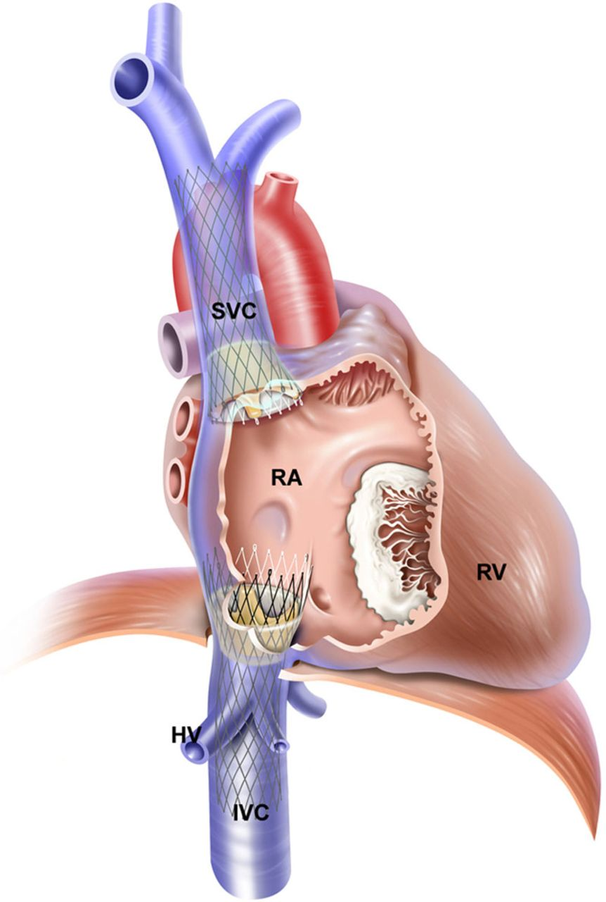
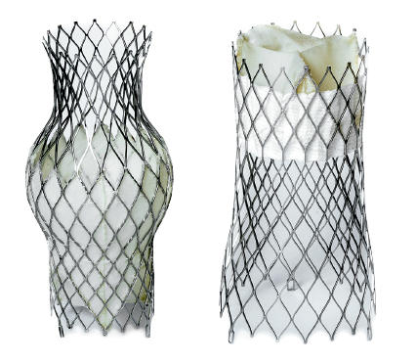
CPT® Additions
TricValve® - Transcatheter Bicaval Valves System
TricValve® - Transcatheter Bicaval Valves System is a system of two self-expanding biological valves for the treatment of patients with hemodynamically relevant tricuspid insufficiency and caval reflux. The prostheses re implanted percutaneously into the superior and inferior vena cava without disturbing the native tricuspid valve. It is especially intended for use for patients at extreme risk or who are inoperable for open surgical therapy.
https://youtu.be/HUbgBk6utP8
Notes:
-Minimally invasive transcatheter bicaval system for patients with TR and right heart failure. The implantation of self-expanding valves into the superior (SVC) and inferior (IVC) vena cava effectively abolishes caval reflux and increases cardiac output by reducing backward regurgitant flow into patients with clinically relevant TR. This will help eliminate peripheral venous congestion reducing right heart failure symptoms and improving the overall clinical condition of patients.

Slide 17
CPT® Additions
Category III Codes- Effective 7/1/2023
CPT Codes 0805T and 0806T
Diagnostic right and left heart catheterization codes (93451, 93452, 93453, 93456, 93457, 93458, 93459, 93460, 93461, 93593, 93594, 93595, 93596, 93597, 93598) should not be used with 0805T, 0806T to report:
Contrast injections, angiography, road-mapping, and/or fluoroscopic guidance for the transcatheter CAVI,
Left ventricular angiography to assess tricuspid regurgitation for guidance of the transcatheter CAVI, or
Right and left heart catheterization for hemodynamic measurements before, during, and after transcatheter superior and inferior vena cava prosthetic valve implantation for guidance.

Slide 18
CPT® Additions
Category III Codes- Effective 7/1/2023
CPT Codes 0805T and 0806T
Diagnostic right and left heart catheterization codes (93451, 93452, 93453, 93456, 93457, 93458, 93459, 93460, 93461, 93593, 93594, 93595, 93596, 93597, 93598) and diagnostic coronary angiography codes (93454, 93455, 93456, 93457, 93458, 93459, 93460, 93461, 93563, 93564) may be reported with 0805T, 0806T, representing separate and distinct services from CAVI, if:
No prior study is available and a full diagnostic study is performed, or
A prior study is available, but as documented in the medical record:
There is inadequate visualization of the anatomy and/or pathology, or
The patient’s condition with respect to the clinical indication has changed since the prior study, or
There is a clinical change during the procedure that requires new evaluation.
For same session or same day diagnostic cardiac catheterization services, the appropriate diagnostic cardiac catheterization code(s) may be reported by appending modifier 59 indicating separate and distinct procedural service from the transcatheter superior and inferior vena cava prosthetic valve implantation procedures.

Slide 19
CPT® Additions
Category III Codes- Effective 7/1/2023
CPT Codes 0805T and 0806T
Percutaneous coronary interventional therapeutic procedures may be reported separately, when performed.
When transcatheter ventricular support is required in conjunction with CAVI, the appropriate ventricular assist device (VAD) procedure codes (33990, 33991, 33992, 33993, 33995, 33997) or balloon pump insertion codes (33967, 33970, 33973) may be reported.
When cardiopulmonary bypass is performed in conjunction with CAVI, 0805T and 0806T may be reported with the appropriate add-on code for percutaneous peripheral bypass (33367), open peripheral bypass (33368), or central bypass (33369).

Slide 20
CPT® Additions
Category III Codes- Effective 7/1/2023
0807T, Pulmonary tissue ventilation analysis using software-based processing of data from separately captured cinefluorograph images; in combination with previously acquired computed tomography (CT) images, including data preparation and transmission, quantification of pulmonary tissue ventilation, data review, interpretation and report
Do not report 0807T in conjunction with 76000, 78579, 78582, 78598
0808T, Pulmonary tissue ventilation analysis using software-based processing of data from separately captured cinefluorograph images; in combination with computed tomography (CT) images taken for the purpose of pulmonary tissue ventilation analysis, including data preparation and transmission, quantification of pulmonary tissue ventilation, data review, interpretation and report
Do not report 0808T in conjunction with 71250, 71260, 71270, 71271, 76000, 78579, 78582, 78598
Notes:
This is performed to evaluate lung function. Ventilation is one of two components of lung function, ventilation and perfusion. Ventilation refers to the ability of the air to reach all areas of the lung. This code is not for the actual test… it’s for the analysis of the results using a software that analyzes cinefluorograph images in combination with a CT image to quantify ventilation of pulmonary tissue, thereby providing support to physicians in their assessment of patients with lung diseases. The XV Lung Ventilation Analysis Software measures the tissue motion of the lung, at all locations throughout the lung, and at all phases of the breath. It uses these motion measurements to calculate the 4-dimensional (4D) ventilation of lung tissues
0807T- do not report with fluoroscopy codes, pulmonary ventilation imaging codes, perfusion and ventilation codes, all included within the code.
0808T- do not report with the codes mentioned that can’t be reported with 0807T, but also added CT scan codes here. CT scan is already included.
Difference between these two codes, the first is using a previously acquired CT image.. The second is using a CT scan that was taken at that time for the purpose of this ventilation analysis and is included in the code.

Slide 21
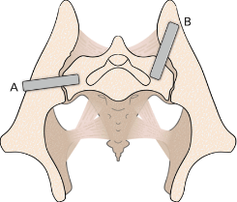
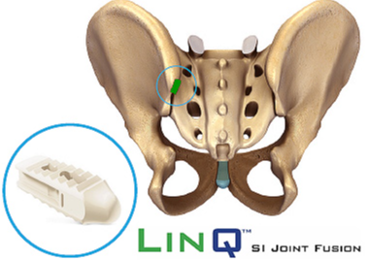
CPT® Additions
Category III Codes- Effective 7/1/2023
0809T, Arthrodesis, sacroiliac joint, percutaneous or minimally invasive (indirect visualization), with image guidance, placement of transfixing device(s) and intra-articular implant(s), including allograft or synthetic device(s)
For bilateral procedure, report 0809T with modifier 50
Notes:
When you wanted to do a percutaneous arthrodesis of the sacroiliac joint utilizing both a transfixation device and an intra-articular implant you would have to use 27299 which is the unlisted procedure of the pelvis or hip joint. Now we have this new code for that circumstance.
SI joint procedures include two distinct types: one type that uses laterally placed transfixing devices via a transiliac approach (crossing the joint), and another that uses intra-articular placement of bone allograft products or devices typically placed via a posterior, or “dorsal,” approach (within the joint).
Picture 1: Lateral transiliac transfixing devices. (A) Typical lateral transiliac trajectory. (B) Posterolateral transiliac trajectory.
Picture 2: bone implant in the sacroiliac joint to stabilize and fuse it.

Slide 22
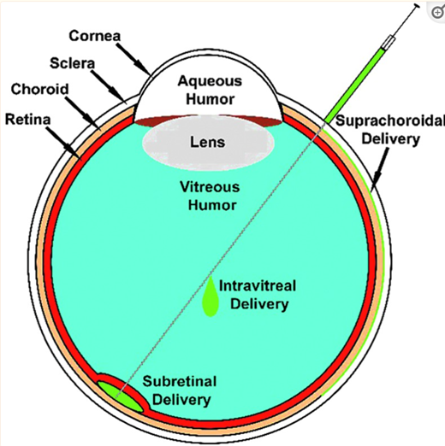
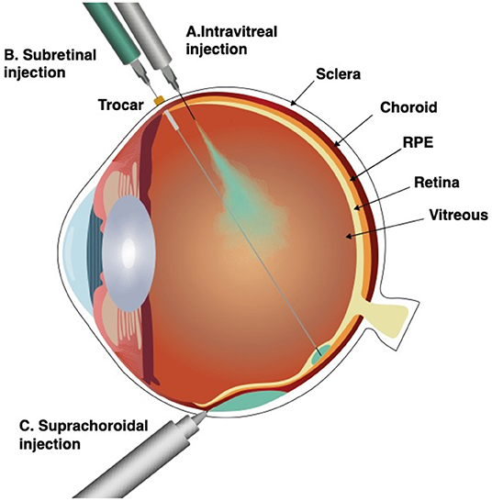
CPT® Additions
Category III Codes- Effective 7/1/2023
0810T, Subretinal injection of a pharmacologic agent,
including vitrectomy and 1 or more retinotomies
Report medication separately
Do not report 0810T in conjunction with 67036,
67039, 67040, 67041, 67042, 67043
Notes:
Not a whole lot of information on this. Mostly used with ocular gene and cellular therapy. The subretinal route is used because other deliveries of the medication can lead to damage of the retina so they need to be very specific about how this is delivered.
Subretinal injection, delivers the therapeutic suspension immediately under the sensory retina, into the subretinal space, a virtual space between the photoreceptors and the retinal pigment epithelium (RPE)
Since the placement of the needle has to be so precise they are exploring using microprecision robot systems for this procedure, but it’s not currently in use.to my knowledge (article was from last year)
0810T- Do not use with 67036, 67039, 67040, 67041, 67042, 67043- codes for vitrectomy and this procedure code includes vitrectomy.
0810T, https://www.frontiersin.org/articles/10.3389/fmed.2022.846782/full

Slide 23
CPT® Additions
Vaccine Code- Effective 5/3/2023
90679, Respiratory syncytial virus vaccine, preF, recombinant, subunit, adjuvanted, for intramuscular use
Arexvy, made by GSK
Approved for adults 60+ years
Single dose (0.5 mL) intramuscular injection
Notes:
“RSV” Usually relate this with babies or young children but it can actually be dangerous for seniors too (particularly if they have underlying heart conditions, lung disease, or weakened immune systems). First RSV vaccine – 60 years in the making.
Keep eye out.. More RSV vaccines on the way. All the work on the RSV vaccine actually helped with speeding the development of the Covid vaccine.
Late 1960s vaccine developed and tested on animals.. Given to children… looked promising but trial found that 80% of patients who received the vaccine required hospitalization compared to 5% who had placebo and there were also deaths. This lead to many of the guardrails currently in place around clinical trials for vaccines.

Slide 24
CPT® Revisions

Slide 25
CPT® Revisions
PLA Code- Effective 7/1/2023
0308U, Cardiology (coronary artery disease [CAD]), analysis of 3 proteins (high sensitivity [hs] troponin, adiponectin, and kidney injury molecule-1 [KIM-1]) with 3 clinical parameters (age, sex, history of cardiac intervention), plasma, algorithm reported as a risk score for obstructive CAD

Slide 26
CPT® Deletions

Slide 27
CPT® Deletions
PLA Codes- Expiration 6/30/2023
0053U, Oncology (prostate cancer), FISH analysis of 4 genes (ASAP1, HDAC9, CHD1 and PTEN), needle biopsy specimen, algorithm reported as probability of higher tumor grade
0143U, Drug assay, definitive, 120 or more drugs or metabolites, urine, quantitative liquid chromatography with tandem mass spectrometry (LC-MS/MS) using multiple reaction monitoring (MRM), with drug or metabolite description, comments including sample validation, per date of service
0144U, Drug assay, definitive, 160 or more drugs or metabolites, urine, quantitative liquid chromatography with tandem mass spectrometry (LC-MS/MS) using multiple reaction monitoring (MRM), with drug or metabolite description, comments including sample validation, per date of service
0145U, Drug assay, definitive, 65 or more drugs or metabolites, urine, quantitative liquid chromatography with tandem mass spectrometry (LC-MS/MS) using multiple reaction monitoring (MRM), with drug or metabolite description, comments including sample validation, per date of service
0146U, Drug assay, definitive, 80 or more drugs or metabolites, urine, by quantitative liquid chromatography with tandem mass spectrometry (LC-MS/MS) using multiple reaction monitoring (MRM), with drug or metabolite description, comments including sample validation, per date of service

Slide 28
CPT® Deletions
PLA Codes- Expiration 6/30/2023
0147U, Drug assay, definitive, 85 or more drugs or metabolites, urine, quantitative liquid chromatography with tandem mass spectrometry (LC-MS/MS) using multiple reaction monitoring (MRM), with drug or metabolite description, comments including sample validation, per date of service
0148U, Drug assay, definitive, 100 or more drugs or metabolites, urine, quantitative liquid chromatography with tandem mass spectrometry (LC-MS/MS) using multiple reaction monitoring (MRM), with drug or metabolite description, comments including sample validation, per date of service
0149U, Drug assay, definitive, 60 or more drugs or metabolites, urine, quantitative liquid chromatography with tandem mass spectrometry (LC-MS/MS) using multiple reaction monitoring (MRM), with drug or metabolite description, comments including sample validation, per date of service
0150U, Drug assay, definitive, 120 or more drugs or metabolites, urine, quantitative liquid chromatography with tandem mass spectrometry (LC-MS/MS) using multiple reaction monitoring (MRM), with drug or metabolite description, comments including sample validation, per date of service

Slide 29
HCPCS Additions

Slide 30
HCPCS Additions
Outpatient PPS- Effective 7/1/2023
C9150, Xenon Xe-129 hyperpolarized gas, diagnostic, per study dose
C9151, Injection, pegcetacoplan, 1 mg
Empaveli™
C9784, Gastric restrictive procedure, endoscopic sleeve gastroplasty, with esophagogastroduodenoscopy and intraluminal tube insertion, if performed, including all system and tissue anchoring components
https://www.hopkinsmedicine.org/health/treatment-tests-and-therapies/endoscopic-sleeve-gastroplasty
C9785, Endoscopic outlet reduction, gastric pouch application, with endoscopy and intraluminal tube insertion, if performed, including all system and tissue anchoring components
TORe Procedure
C9786, Echocardiography image post processing for computer aided detection of heart failure with preserved ejection fraction, including interpretation and report
Notes:
CMS put out very limited information on these
C9150- Xenon Xe 129 is a contrast agent composed of hyperpolarized gas. Upon inhalation, the hyperpolarized xenon 129 gas is distributed throughout the lungs. MRI, immediately following HP129Xe administration, allows for the visualization of lung structures based on the distribution pattern of the gas. This may aid in the diagnosis of certain lung abnormalities
C9151- Used to treat adults with a disease called paroxysmal nocturnal hemoglobinuria (PNH). Disorder that leads to impaired production of blood cells.
C9784 – procedure used to address obesity. It can reduce the size of the stomach without the need for an incision through the skin. Performed with an endoscopic stitching device to reduce the size of the stomach and to shorten and reshape the stomach which helps it to empty into the intestines slower (making you feel fuller longer), minimally invasive, less risk for complications, and it is also reversible. So the traditional laparoscopic sleeve gastrectomy also reduces the stomach size but it does so by removing a piece of the stomach. In this procedure they insert the endoscopic stitching device thru mouth and stitch stomach in a folded over type shape. https://www.hopkinsmedicine.org/health/treatment-tests-and-therapies/endoscopic-sleeve-gastroplasty. Link to video of procedure.
C9785- This procedure is for patients who regain weight after gastric bypass surgery. aims to reduce the size of the opening between the stomach pouch and the small intestine to slow stomach emptying and help you feel fuller longer. Surgeon inserts an endoscope through patient’s mouth and guides it into the stomach pouch that had been created during the previous gastric bypass surgery. Heat treatment is applied to the edge of the gastric outlet (which is the opening between the gastric pouch and the small intestine.. Once the heat treatment is applied to the gastric outlet, the doctor uses a suturing device on the end of the endoscope to tighten the gastric outlet and reduce it approximately 8-10 mm. When this opening is enlarged, it makes the patient feel hungry faster because food is emptied faster. So by narrowing this outlet it will help the food to empty to the small intestine slower and the patient to feel fuller longer.
C9786- “to describe the diagnostic aid service for routine functional cardiovascular assessment using echocardiography.” This is just a software that helps with analyzing echo images and creates a report for the doctor to review.

Slide 31
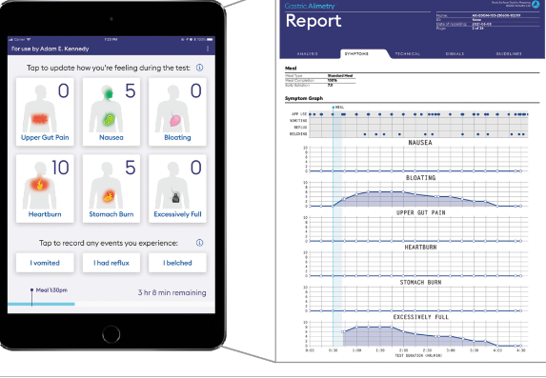
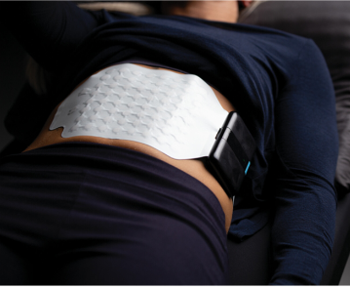
HCPCS Additions
Outpatient PPS- Effective 7/1/2023
C9787, Gastric electrophysiology mapping with simultaneous patient symptom profiling
Notes:
C9787- non invasive method to assess gastric function. Electrodes are placed on the abdomen to detect electrophysiological biomarkers, such as slow wave direction, and simultaneously the patient is digitally logging their symptoms.

Slide 32
HCPCS Additions
Drugs Administered Other Than Oral Method- Effective 7/1/2023
J0137, Injection, acetaminophen (Hikma) not therapeutically equivalent to J0131, 10 mg
J0206, Injection, allopurinol sodium, 1 mg
J0216, Injection, alfentanil hydrochloride, 500 micrograms
J0457, Injection, aztreonam, 100 mg
J0665, Injection, bupivicaine, not otherwise specified, 0.5 mg
J0736, Injection, clindamycin phosphate, 300 mg
J0737, Injection, clindamycin phosphate (Baxter), not therapeutically equivalent to J0736, 300 mg
J1576, Injection, immune globulin (Panzyga), intravenous, non-lyophilized (e.g., liquid), 500 mg
J1805, Injection, esmolol hydrochloride, 10 mg
J2305, Injection, nitroglycerin, 5 mg
Notes:
https://www.cms.gov/files/document/2023-hcpcs-application-summary-quarter-1-2023-drugs-and-biologicals-updated-04/28/2023.pdf page 52 all codes
These HCPCS codes were created because they are products that are approved under the NDA or BLA that are rated as not therapeutically equivalent to their reference listed drug in the FDA’s orange book that has an existing code , so they are considered “single source” products.
NDA is an application to permit the sale and marketing of a new drug in the United States. Drugs that are approved via an NDA pathway are regulated under Section 505 of the Food, Drug, & Cosmetics (FD&C) Act. A BLA is a request to introduce, or deliver for introduction, a biological product into interstate commerce
The Orange Book is a list of drugs and pharmaceuticals that the U.S. Food and Drug Administration (FDA) has approved as both safe and effective. Although it is commonly called the Orange Book, its formal name is Approved Drug Products with Th
erapeutic Equivalence Evaluations. The Orange Book is useful for finding generic drug equivalents, which may often be much lower cost for patients. A therapeutically equivalent drug must meet all the criteria of pharmaceutically equivalent drugs (same active ingredient, same dosage/concentration/strength, same route of delivery) and also have the same form/identity (e.g., tablet or capsule) as the brand drug. Additionally, it must also be tested for bioequivalence, meaning they are processed and metabolized by the body in the same way.
Single source drug means a drug that is produced and distributed under an original New Drug Application approved by the federal Food and Drug Administration. A drug ceases to be a single-source drug when the same drug in the same dosage form and strength manufactured by another manufacturer is approved by the federal Food and Drug Administration under the provisions for an Abbreviated New Drug Application.
Not going to go through these products to tell you it’s indications because these products aren’t new, many have been around for years and you probably have heard of many of these already, these particular ones are just not considered therapeutically equivalent so a new code was needed.
tps://www.cms.gov/files/document/2023-hcpcs-application-summary-quarter-1-2023-drugs-and-biologicals-updated-04/28/2023.pdf page 52 all codes

Slide 33
HCPCS Additions
Drugs Administered Other Than Oral Method- Effective 7/1/2023
J1806, Injection, esmolol hydrochloride (WG Critical Care) not therapeutically equivalent to J1805, 10 mg
J1811, Insulin (Fiasp) for administration through DME (i.e., insulin pump) per 50 units
J1812, Insulin (Fiasp), per 5 units
J1813, Insulin (Lyumjev) for administration through DME (i.e., insulin pump) per 50 units
J1814, Insulin (Lyumjev), per 5 units
J1836, Injection, metronidazole, 10 mg
J1920, Injection, labetalol hydrochloride, 5 mg
J1921, Injection, labetalol hydrochloride (Hikma) not therapeutically equivalent to J1820, 5 mg
J1941, Injection, furosemide (Furoscix), 20 mg
Notes:
All codes. https://www.cms.gov/files/document/2023-hcpcs-application-summary-quarter-1-2023-drugs-and-biologicals-updated-04/28/2023.pdf page 52

Slide 34
HCPCS Additions
Drugs Administered Other Than Oral Method- Effective 7/1/2023
J2371, Injection, phenylephrine hydrochloride, 20 micrograms
J2372, Injection, phenylephrine hydrochloride (Biorphen), 20 micrograms
J2427, Injection, paliperidone palmitate extended release (INVEGA HAFYERA, or INVEGA TRINZA), 1 mg
J2598, Injection, vasopressin, 1 unit
J2599, Injection, vasopressin (American Regent) not therapeutically equivalent to J2598, 1 unit
J7213, Injection, coagulation factor IX (recombinant), IXINITY, 1 i.u.
J9322, Injection, pemetrexed (BluePoint) not therapeutically equivalent to J9305, 10 mg
https://www.cms.gov/files/document/frequently-asked-questions-single-source-drugs-and-biologicals.pdf
Notes:
Pg 52

Slide 35
HCPCS Additions
Drugs Administered Other Than Oral Method- Effective 7/1/2023
J2249, Injection, remimazolam, 1 mg- BYFAVO®
J2329, Injection, ublituximab-xiiy, 1mg- Briumvi™
J2561, Injection, phenobarbital sodium (Sezaby), 1 mg- Sezaby™
J2806, Injection, sincalide (MAIA) not therapeutically equivalent to J2805, 5 micrograms- Sincalide
J1440, Fecal microbiota, live - jslm, 1 ml- Rebyota™
J1961, Injection, lenacapavir, 1 mg- SUNLENCA®
Notes:
Brand names are listed behind the code description
J2249- The FDA approved indication is for the induction and maintenance of procedural sedation in adults undergoing procedures lasting 30 minutes or less.
J2329-FDA-approved as a cytolytic antibody indicated for the treatment of relapsing forms of multiple sclerosis, to include clinically isolated syndrome,
relapsing-remitting disease, and active secondary progressive disease, in adults.
J2561-approved by the Food and Drug Administration (FDA) indicated for the treatment of neonatal seizures in term and preterm infants.
J2806-approved by the Food and Drug Administration (FDA) indicated in adults to stimulate gallbladder contraction, to be
assessed by various methods of diagnostic imaging, or to be obtained by a duodenal
aspiration sample of concentrated bile for analysis of cholesterol, bile salts, phospholipids,
and crystals. Sincalide can stimulate pancreatic secretion in combination with secretin prior
to obtaining a duodenal aspirate for analysis of enzyme activity, composition, and can
accelerate the transit of a barium meal through the small bowel, thereby decreasing the time
and extent of radiation associated with fluoroscopy and x-ray examination of the intestinal
tract.
J1440 Just a note, this is a reused HCPCS code that previously expired 12/31/2013. REBYOTA® was approved by the Food &
Drug Administration (FDA) indicated for rectal administration for the prevention of recurrence of
Clostridioides difficile infection (CDI) in individuals 18 years of age and older, following
antibiotic treatment for recurrent CDI.
J1961- FDA-approved as a human immunodeficiency virus type 1 (HIV1) capsid inhibitor, to be used in combination with other antiretroviral(s); and is indicated for
the treatment of HIV-1 infection in heavily treatment-experienced adults with multidrug
resistant HIV-1 infection failing their current antiretroviral regimen due to resistance,
intolerance, or safety considerations.

Slide 36
HCPCS Additions
Drugs Administered Other Than Oral Method- Effective 7/1/2023
J9029, Injection, nadofaragene firadenovec-vncg, per therapeutic dose- ADSTILADRIN®
J9056, Injection, bendamustine hydrochloride (Vivimusta), 1 mg- VIVIMUSTA
J9058, Injection, bendamustine hydrochloride (Apotex), 1 mg- Apotex
J9059, Injection, bendamustine hydrochloride (Baxter), 1 mg- Baxter
J9063, Injection, mirvetuximab soravtansine-gynx, 1 mg- ELAHERE™
J9259, Injection, paclitaxel protein-bound particles (American Regent) not therapeutically equivalent to J9264, 1 mg- American Regent
J9323, Injection, pemetrexed ditromethamine, 10 mg- Hospira
Notes:
J9029- instilled once every three months into the bladder via a urinary catheter, adenovirus vector-based gene therapy for intravesical use for the treatment of adult patients
with high-risk Bacillus Calmette-Guérin unresponsive non-muscle invasive bladder cancer
with carcinoma in situ with or without papillary tumors.
J9056- indicated for the treatment of adult patients with chronic lymphocytic leukemia (CLL) and
indolent B-cell non-Hodgkin lymphoma (NHL) that has progressed during or within six
months of treatment with rituximab or a rituximab-containing regimen
J9058- indicated for treatment of adult patients with
chronic lymphocytic leukemia (CLL), whose efficacy relative to first line therapies other than
chlorambucil has not been established, and indolent B-cell non-Hodgkins lymphoma (NHL)
that has progressed during or within six months of treatment with rituximab or a rituximab-containing regimen.
J9059- indicated for the
treatment of adult patients with chronic lymphocytic leukemia (CLL) and indolent B-cell
non-Hodgkin’s lymphoma (NHL) that has progressed during or within six months of
treatment with rituximab or a rituximab-containing regimen.
J9063- antibody-drug conjugate (ADC)
directed against folate receptor alpha, a cell-surface protein highly expressed in ovarian
cancer. According to the applicant, this drug was granted accelerated approval for the
treatment of adult patients with folate receptor alpha-positive, platinum-resistant epithelial
ovarian, fallopian tube, or primary peritoneal cancer, who have received 1 to 3 prior system
treatment regimens
J9259- a microtubule inhibitor indicated for the treatment of and administered
intravenously (IV) by a healthcare professional for the following indications. Metastatic
breast cancer after failure of combination chemotherapy for metastatic disease or relapse
within 6 months of adjuvant chemotherapy; prior therapy should have included an
anthracycline unless clinically contraindicated., Another indication is for locally advanced or metastatic
non-small cell lung cancer (NSCLC) as a first-line treatment in combination with carboplatin
in patients who are not candidates for curative surgery or radiation therapy, metastatic
adenocarcinoma of the pancreas as a first-line treatment in combination with gemcitabine.
J9323-a folate analog metabolic inhibitor indicated for
patients with locally advanced or metastatic, non-squamous non-small cell lung cancer
(NSCLC) who have a creatinine clearance (calculated by Cockcroft-Gault equation) of 45
mL/min or greater.

Slide 37
HCPCS Additions
Drugs Administered Other Than Oral Method- Effective 7/1/2023
J9347, Injection, tremelimumab-actl, 1 mg- IMJUDO®
J9350, Injection, mosunetuzumab-axgb, 1 mg- LUNSUMIO™
J9380, Injection, teclistamab-cqyv, 0.5 mg- TECVAYLI™
J9381, Injection, teplizumab-mzwv, 5 mcg- TZIELD™
Notes:
J9347- a cytotoxic T-lymphocyte-associated antigen 4
(CTLA-4) blocking antibody indicated, in combination with durvalumab, for the treatment of
adult patients with unresectable hepatocellular carcinoma (uHCC). C
J9350 pg 9- This is a reused HCPCS that expired 12/31/2010. ) is a bispecific CD20-directed CD3 T-cell engager
indicated for the treatment of adult patients with relapsed or refractory follicular lymphoma
after two or more lines of systemic therapy. LUNSUMIO™ is designed to enable a patient’s
own immune system to target and eradicate B-cells, including those that cause malignant
disease.
J9380 pg 11- This is a reused HCPCS that expired 12/31/2010. ™ is a bispecific B-cell maturation antigen -
directed CD3 T-cell engager indicated for the treatment of adult patients with relapsed or
refractory multiple myeloma who have received at least four prior lines of therapy, including
a proteasome inhibitor, an immunomodulatory agent and an anti-CD38 monoclonal antibody.
J9381- Its function is as a CD3-directed antibody to delay the onset of Stage 3 type 1
diabetes (T1D) in adult and pediatric patients aged 8 years and older with Stage 2 T1D.

Slide 38
HCPCS Additions
Temporary Codes-Effective 7/1/2023
Q4272, Esano A, per square centimeter- Esano™ A
Q4273, Esano AAA, per square centimeter- Esano™ AAA
Q4274, Esano AC, per square centimeter- Esano™ AC
Q4275, Esano ACA, per square centimeter- Esano™ ACA
Q4276, Orion, per square centimeter- ORION Amniotic Membrane
Q4277, Woundplus membrane or E-Graft, per square centimeter- WoundPlus™ Membrane
Notes:
Q4272- a single-layer, decellularized, dehydrated human amniotic
membrane allograft that is intended for use as a cover or barrier for acute and chronic wounds
and to provide protective coverage from the surrounding environment for acute and chronic
wounds. applied directly to the wound; it
adheres to the wound bed without fixation.
Q4273- is a tri-layer,
Q4274 - dual-layer, (same as above)
Q4275 - dehydrated allograft that consists of a dehydrated triple layer amnion allograft tissue matrix and will accommodate a variety of handling characteristics.
Q4276 -a sterile dehydrated dual layered human amniotic membrane allograft. ORION Amniotic Membrane
is intended to serve as a barrier or cover for acute and chronic wounds and for use as a barrier
to protect wounds from the surrounding environment. Mentioned that it is sterilized by e-beam to meet a sterility assurance level of 10-6.
Q4277- WoundPlus™ Membrane consists of dehydrated and devitalized
human derived amniotic membrane that has been processed with HydraTek™ technology.
WoundPlus™ Membrane is a single layer amnion-only membrane allograft intended for use
as a barrier, wrap or cover for acute and chronic wounds.

Slide 39
HCPCS Additions
Temporary Codes- Effective 7/1/2023
Q4278, Epieffect, per square centimeter- EPIEFFECT®
Q4280, Xcell Amnio Matrix, per square centimeter- Xcell Amnio Matrix®
Q4281, Barrera SL or Barrera DL, per square centimeter- Barrera™ SL and Barrera™ DL
Q4282, Cygnus Dual, per square centimeter- CYGNUS Dual
Q4283, Biovance Tri-Layer or Biovance 3L, per square centimeter- Biovance® 3L
Q4284, Dermabind SL, per square centimeter- DermaBind SL™
Q5131, Injection, adalimumab-aacf (Idacio), biosimilar, 20 mg- IDACIO® (biosimilar to Humira®)
Notes:
Q4278- minimally manipulated, lyophilized, non-viable cellular
allograft derived from human amniotic membrane.
Q4280 -a lyophilized amniotic membrane allograft
that is aseptically processed to preserve the native extracellular matrix and endogenous
proteins. Xcell Amnio Matrix® acts as a barrier and provide protective coverage from the
surrounding environment for acute and chronic wounds such as partial and full thickness
Wounds,
Q4281- are dehydrated amniotic
membrane allograft. Barrera™ SL and Barrera™ DL are intended to serve as a protective
wound cover or barrier to offer protection from the surrounding environment in wounds,
including surgically created wounds
Q4282-dual amnion allograft is derived from the amnion layer of the fetal membrane and is
processed using aseptic techniques. The product is terminally sterilized via electron-beam
irradiation
Q4283 - a triple-layer decellularized, dehydrated human amniotic
membrane, sterilized using e-beam irradiation. Biovance® 3L is intended to be used as a
cover or to protect from the surrounding environment in wound and surgical repair and
reconstruction procedures
Q4284 -an amnion derived allograft for management
of wounds and burn injuries. DermaBind SL™ is a sterile, single use, dehydrated allograft
derived from donated human amnion membrane. is fully resorbable and
does not have to be removed from the wound bed.
Q5131- approved as a biosimilar to Humira® (adalimumab).
IDACIO® is a tumor necrosis factor blocker indicated for reducing signs and symptoms of
rheumatoid arthritis, juvenile idiopathic arthritis, psoriatic arthritis, ankylosing spondylitis,
Crohn’s disease, ulcerative colitis and plaque psoriasis. I

Slide 40
HCPCS Revisions

Slide 41
HCPCS Revisions
Effective 7/1/2023
J2426, [Long Descriptor] Injection, paliperidone palmitate extended release (Invega Sustenna), 1 mg
G0460, [Long Descriptor] Autologous platelet rich plasma or other blood-derived product for non-diabetic chronic wounds/ulcers, including as applicable phlebotomy, centrifugation or mixing, and all other preparatory procedures, administration and dressings, per treatment
G0465, [Long Descriptor] Autologous platelet rich plasma (PRP) or other blood-derived product for diabetic chronic wounds/ulcers, using an FDA-cleared device for this indication, (includes as applicable administration, dressings, phlebotomy, centrifugation or mixing, and all other preparatory procedures, per treatment)
J9323, [Short Descriptor] Inj pemetrexed ditromethamin
[Long Descriptor] Injection, pemetrexed ditromethamine, 10 mg

Slide 42
HCPCS Deletions

Slide 43
HCPCS Deletions
CPT/HCPCS Code | Long Description | Potential Replacement Code(s) | NDCs Affected
C9146 | Injection, mirvetuximab soravtansine-gynx, 1 mg | J9063 | 72903-0853-01
C9147 | Injection, tremelimumab-actl, 1 mg | J9347 | 0310-4505-25 0310-4535-30
C9148 | Injection, teclistamab-cqyv, 0.5 mg | J9380 | 57894-0449-01 57894-0450-01
C9149 | Injection, teplizumab-mzwv, 5 mcg | J9381 | 73650-0316-01 73650-0316-10 73650-0316-14
Notes:
C9149– previously mentioned is being replaced by new code J9381 Injection, teplizumab-mzwv, 5 mcg

Slide 44
HCPCS Deletions
CPT/HCPCS Code | Long Description | Potential Replacement Code(s) | NDCs Affected
J2370 | Injection, phenylephrine hcl, up to 1 ml | J2371 J2372 | 00641-6142-01, 00641-6142-25, 00641-6188-01, 00641-6188-10, 00641-6189-01, 00641-6189-10, 00641-6229-01, 00641-6229-25, 00781-3422-71, 00781-3422-92, 00781-3458-75, 00781-3458-95, 00781-3466-70, 00781-9227-75, 00781-9227-95, 00781-9228-70, 16729-0464-08, 16729-0464-63, 16729-0465-03, 16729-0465-31, 16729-0466-03, 25021-0315-01, 25021-0315-98, 25021-0315-99, 42023-0214-01, 42023-0214-10, 42023-0215-01, 51754-4000-01, 51754-4000-03, 51754-4020-01, 55150-0300-01, 55150-0300-25, 55150-0301-01, 55150-0301-10, 55150-0302-01, 55154-5129-05, 55154-8226-05, 61990-0211-00, 61990-0211-03, 61990-0212-00, 61990-0212-02, 61990-0213-00, 61990-0213-01, 63323-0751-00, 63323-0751-01, 63323-0751-03, 63323-0751-05, 63323-0751-10, 63323-0751-13, 70069-0801-01, 70069-0801-25, 70069-0802-01, 70069-0802-10, 70069-0803-01, 70121-1577-01, 70121-1577-05, 70121-1578-01, 70121-1578-07, 70121-1579-01, 70594-0063-01, 70594-0063-02, 70594-0064-01, 70594-0064-02, 70594-0065-01, 70594-0065-02, 70756-0621-25, 70756-0621-82, 70756-0622-10, 70756-0622-85, 70756-0623-86, 71288-0807-01, 71288-0807-02, 71288-0808-75, 71288-0808-76, 71288-0808-77, 72485-0506-01, 72572-0570-01, 72572-0570-10, 72572-0571-01, 72572-0571-25, 76014-0004-25, 76014-0004-30, 81284-0211-00, 81284-0211-25, 81284-0212-00, 81284-0212-10, 81284-0213-00, 81284-0213-01

Slide 45
HCPCS Deletions
CPT/HCPCS Code | Long Description | Potential Replacement Code(s) | NDCs Affected
S0020 | Injection, bupivicaine hydrochloride, 30 ml | J0665 | 00143-9328-01, 00143-9328-10, 00143-9329-01, 00143-9329-10, 001439-9330-01, 00143-9330-10, 00143-9331-01, 00143-9331-10, 00143-9332-01, 00143-9332-10, 00143-9333-01, 00143-9333-10, 00143-9334-01, 00143-9334-10, 00143-9335-01, 00143-9335-10, 00409-1159-01, 00409-1159-02, 00409-1159-09, 00409-1159-10, 00409-1159-18, 00409-1159-19, 00409-1160-01, 00409-1160-18, 00409-1162-01, 00409-1162-02, 00409-1162-09, 00409-1162-10, 00409-1162-18, 00409-1162-19, 00409-1163-01, 00409-1163-18, 00409-1165-01, 00409-1165-02, 00409-1165-18, 00409-1165-19, 00409-1559-10, 00409-1559-18, 00409-1559-19, 00409-1559-30, 00409-1560-10, 00409-1560-18, 00409-1560-19, 00409-1560-29, 00409-1582-10, 00409-1582-18, 00409-1582-19, 00409-1582-29, 00409-1587-50, 00409-1610-50, 00409-3613-11, 50090-1874-00, 50090-4516-00, 55150-0167-10, 55150-0168-30, 55150-0169-10, 55150-01730-30, 55150-01711-10, 55150-0172-30, 55150-0249-50, 55150-0250-50, 55154-6970-05, 59923-0717-05, 59923-0718-05, 59923-0719-10, 59923-0720-10, 63323-0464-02, 63323-0464-08, 63323-0464-09, 63323-0464-17, 63323-0464-31, 63323-0464-37, 63323-0464-38, 63323-0464-39, 63323-0465-57, 63323-0466-01, 63323-0466-03, 63323-0466-08, 63323-0466-09, 63323-0466-17, 63323-0466-31, 63323-0466-37, 63323-0466-38, 63323-0466-39, 63323-0467-57, 63323-0472-03, 63323-0472-17, 63323-0472-37, 76420-0181-10, 81483-0003-00, 81483-0004-00

Slide 46
HCPCS Deletions
CPT/HCPCS Code | Long Description | Potential Replacement Code(s) | NDCs Affected
S0030 | Injection, metronidazole, 500 mg | J1836 | 00264-5535-32 00338-1055-48 00338-9541-24 00409-0152-01 00409-0152-24 00409-7811-11 00409-7811-37 25021-0131-82 47335-0993-01
S0073 | Injection, aztreonam, 500 mg | J0457 | 00003-2560-16 00003-2570-16 00409-0829-01 00409-0829-11 00409-0830-01 00409-0830-11 63323-0401-01 63323-0401-20 63323-0401-21 63323-0401-24 63323-0401-26 63323-0401-41 63323-0402-01 63323-0402-03 63323-0402-20 63323-0402-24 63323-0402-30 63323-0402-41

Slide 47
HCPCS Deletions
CPT/HCPCS Code | Long Description | Potential Replacement Code(s) | NDCs Affected
S0077 | Injection, clindamycin phosphate, 300 mg | J0736 J0737 | 00009-0728-05, 00009-0728-09, 00009-0775-20, 0009-0775-26, 00009-0870-21, 00009-0870-26, 00009-0902-11, 0009-0902-18, 00009-3051-01, 00009-3051-02, 00009-3381-01, 00009-4073-03, 00009-4073-04, 00009-5095-05, 00009-5095-06, 00338-3410-24, 00338-3410-50, 00338-3612-24, 00338-3612-50, 00338-3616-24, 00338-3616-50, 00338-3814-24, 00338-3814-50, 00338-4114-24, 00338-4114-50, 00338-9545-24, 00338-9545-50, 00338-9549-24, 00338-9549-50, 00338-9553-24, 00338-9553-50, 00781-3288-09, 00781-3288-91, 00781-3289-09, 00781-3289-91, 00781-3290-09, 00781-9220-09, 00781-9221-91, 25021-0115-02, 25021-0115-04, 25021-0115-06, 25021-0115-51, 43066-0993-24, 43066-0995-24, 63323-0282-04, 63323-0282-60, 72572-0074-01, 72572-0074-24, 72572-0076-01, 72572-0076-24

Slide 48
Resources
Agilent Resolution ctDx FIRST. https://www.resolutionbio.com/assays/Resolution-ctDx-FIRST.html
AMBLor® https://amlo-biosciences.com/amblor-2/
Arexvy Highlights of Prescribing Information. https://gskpro.com/content/dam/global/hcpportal/en_US/Prescribing_Information/Arexvy/pdf/AREXVY.PDF
CARDIO inCode-Score. https://genincode.com/cardio-incode-score-us/
CMS HCPCS Application Summaries and Coding Recommendations, First Qtr 2023 HCPCS Coding Cycle. https://www.cms.gov/files/document/2023-hcpcs-application-summary-quarter-1-2023-drugs-and-biologicals-updated-04/28/2023.pdf
CPT® Category III Codes. American Medical Association.
https://www.ama-assn.org/system/files/cpt-category3-codes-long-descriptors.pdf
CPT® PLA Codes. American Medical Association.
https://www.ama-assn.org/practice-management/cpt/cpt-pla-codes

Slide 49
Resources
ESOPREDICT® Barrett's Esophagus Risk Classifier Assay. https://previsedx.com/our-test/esopredict-for-patients/
FRAT®. https://www.fratnow.com/
GaitBetter Announces Category III CPT® Add-On Code for Motor-Cognitive, Semi-Immersive Virtual Reality-Facilitated Gait Training. https://www.prweb.com/releases/2023/2/prweb19143556.htm
Genesys Carrier Screening. https://www.gdilabs.com/carrier-screening-patient
HCPCS Quarterly Update. Centers for Medicare & Medicaid Services. https://www.cms.gov/medicare/coding/hcpcsreleasecodesets/hcpcs-quarterly-update
Hyperpolarized Xenon 129. https://www.cancer.gov/publications/dictionaries/cancer-drug/def/hyperpolarized-xenon-129
InVisionFirst®-Lung. https://neogenomics.com/invisionfirstr-lung

Slide 50
Resources
KawasakiDx. https://www.mprobe.com/kawasaki-dx.htm
Neuropsychiatric Panel EffectiveRx. https://genetworx.com/services/effectiverx-neuropsychiatric-panel/
OncobiotaLUNG. https://www.micronoma.com/
PEPredictDx. https://www.mprobe.com/preeclampsia-dx.htm
PFAS Testing & PFASure™. https://nmslabs.com/solutions/exposure-monitoring/pfas-blood-testing-from-nms-labs
Principles and Clinical Methods of Body Surface Gastric Mapping: Technical Review. https://onlinelibrary.wiley.com/doi/full/10.1111/nmo.14556
Spectrum™ PGT-M. https://www.natera.com/womens-health/spectrum-preimplantation-genetics/

Slide 51
Resources
Strata Select®. https://strataoncology.com/strata-select/
Subretinal Therapy: Technological Solutions to Surgical and Immunological Challenges. https://www.frontiersin.org/articles/10.3389/fmed.2022.846782/full
SYNTap® Biomarker Test. https://ampriondx.com/
Transoral Outlet Reduction. https://www.hopkinsmedicine.org/health/treatment-tests-and-therapies/transoral-outlet-reduction
Tricvalve®-Transcatheter Bicaval Valves System. https://productsandfeatures.com/healthcare-professionals/tricvalve-transcatheter-bicaval-valves/
XV Lung Ventilation Analysis Software. https://accessgudid.nlm.nih.gov/devices/19356870000014

Slide 52
Q&A Document can be found on Healthcatalyst.com under Resources/Webinars

